Slide 1
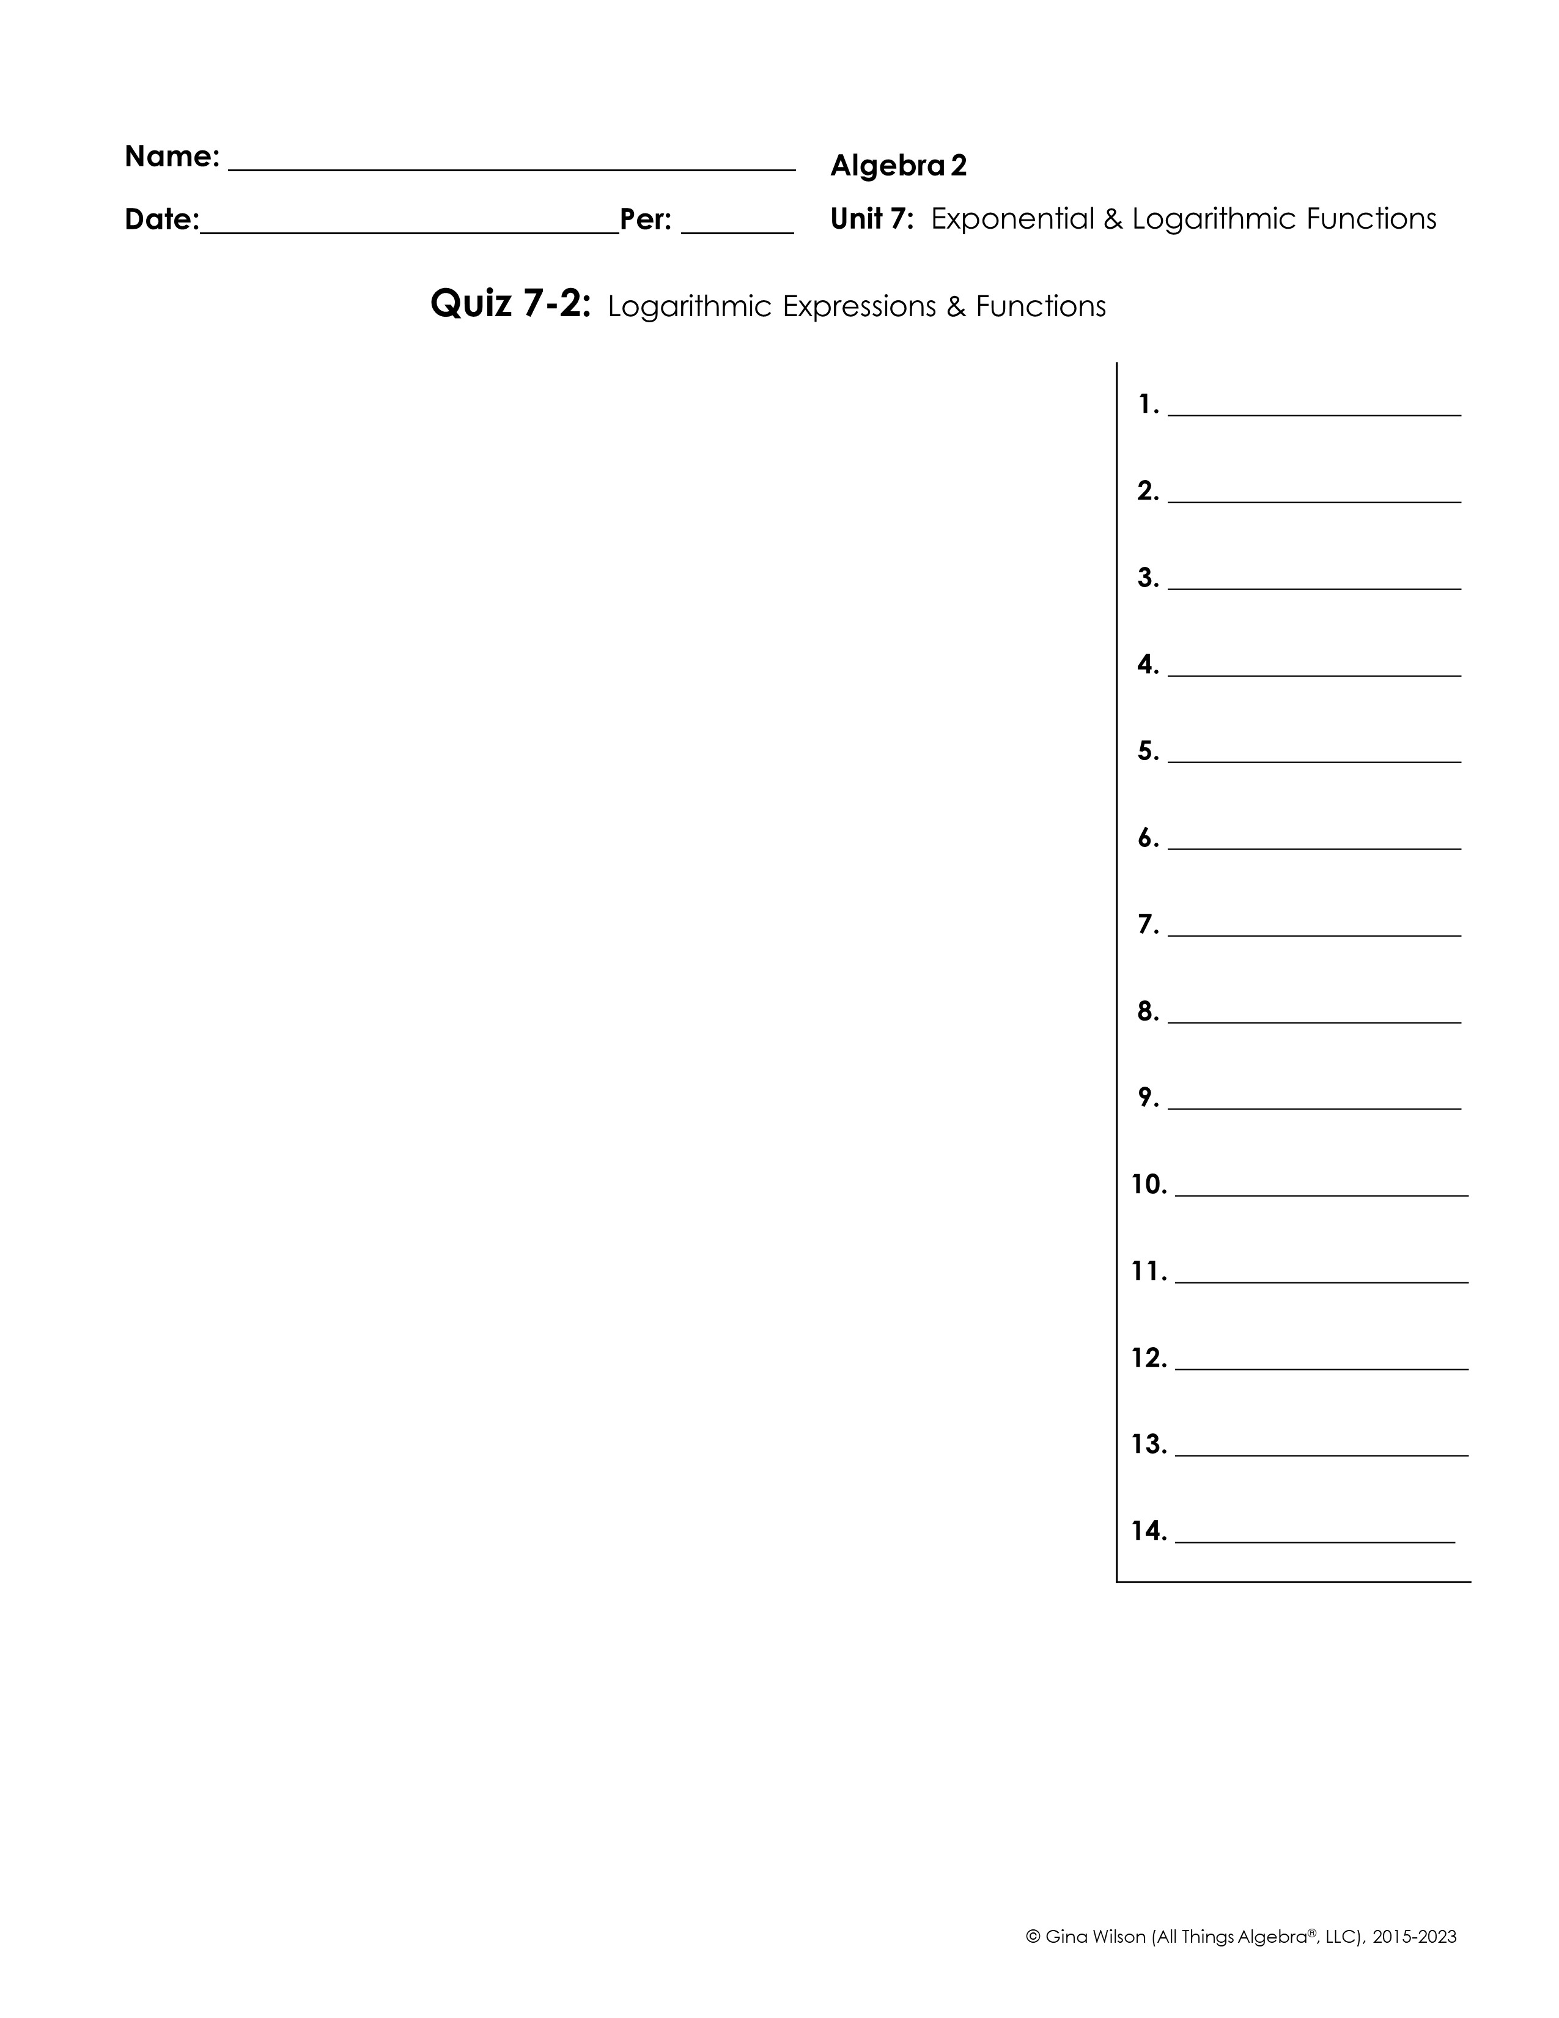
Write each expression in exponential form.
1.
2.
Write each expression in logarithmic form.
3.
4.
Evaluate. Use the change of base formula when necessary.
5.
6.
7.
8.
9.
10.
Condense each log into a single logarithm. DO NOT EVALUATE.
11.
12.
13.
14.

Slide 2

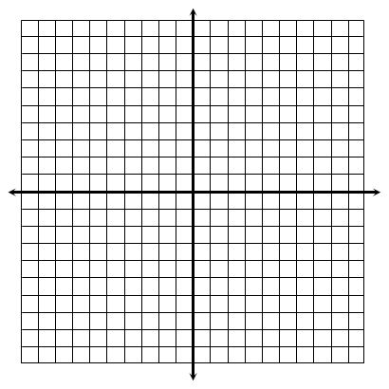
Expand each logarithm.
15.
16.
17.
18.
Graph each function and identify its key characteristics.
19.
Domain: ___________________ Range: ____________________
End Behavior: As _______, As _______,
x-intercept: _________________
Asymptote: _________________
20.
Domain: ___________________ Range: ____________________
End Behavior: As _______, As _______,
x-intercept: _________________
Asymptote: _________________

